Slide 1

Reporting and Testing Checklist

Slide 2
Penetration Test Process and Preparation
Overall Steps
Contacting and Documentation
Scope

Slide 3
Overall Process
Preparation
Customer Interview
Define testing scope (targets)
Define rules of engagement
Complete liability waiver, NDA, permission memo
Create testing team and set roles
Testing
Perform the test, following any applicable methodology
During test, may have daily hot washes of activities and findings
Finish test with informal emerging results brief
Conclusion
Measure findings against business assets or concerns and threats
Write and present report of findings and recommendations
(optional) Re-test and follow up to verify mitigations to security findings

Slide 4
Testing Interview
Penetration testing begins by interviewing the customer
What are the customer’s concerns (potential impacts)?
Government requirements – PCI, HIPPA, National Defense
Downtime and lost revenue
Disclosure of sensitive information
Embarrassment or reputation
Competition
Which of their assets do they want to protect?
What are the possible threats to their assets?
This data may not always be available. We assume worst case scenario - a motivated, well-funded, and capable adversary
What do they want to get out of this test?
A report of their most severe vulnerabilities?
A guide to help them patch the holes before the ship sinks?

Slide 5
Define Scope
We want to have crystal-clear knowledge of
Customer’s expectations
Scope
Target IPs or subnets, domains, applications
What is to be excluded, avoided, off-limits
Important: Avoid Scope Creep!
Documenting what exactly is in and out of scope will prevent this
Pen tests usually spend 1 week on the actual test, then 3+ on reporting
Typical for an on-site network test
May vary depending on the type of test we’re performing
Third-parties
The customer may ask you to test a target they don’t own!
Hardware equipment
Cloud resources
Make sure to understand your targets and get written authorization to test

Slide 6
Scoping: Cloud
You may not even know that some services or targets are cloud-hosted
When testing enterprise or cloud services, be aware of
Who owns the cloud
Is it shared by other tenants?
Would we need explicit permission? (Spoiler alert: yes)
Some services, like Amazon, have a pen test request process
Most likely we can test only what the customer owns, not the third-part network
Platform as a Service (PaaS)
Probably allow application testing only
Infrastructure as a Service (IaaS)
Probably allow application testing only
Software as a Service (SaaS)
Probably will not allow any testing

Slide 7
Scoping: Production vs Test
Many entities have both a production and a test environment
Development and testing takes place on Test environment
Deploy to Production environment carefully to maintain continuity
We need to define what our targets are
Ideally, we want to test the Test environment
Makes sense to the customer, since we don't want to impact their production environment
Realistically, we should test the Production environment
Production and Test environments may not be identical
Ex. Test environment may have local admins and very insecure
More of a real-world assessment of security

Slide 8
Scoping: How should we test?
Based off the customers concerns, define how we are going to test!
Network service vulnerability test
Web app and site test
Internal client and database test
Software coding errors and flaw test
Mobile environment
Wireless assessment
Red Team test
Physical security
Social engineering
Denial of Service attempts
Along with how we’re testing, there should be referenced sections in the Rules of Engagement (ROE)

Slide 9
Rules of Engagement (ROE)
ROE provide both parties with the playbook for this test
ROE includes
Testing times
Points of Contact
Testing schedule, briefings, reporting
Type of pen test
White (Crystal) box / Blue Team
Black box / Red Team
Problem solving
Local admins blocking pen test traffic
Connectivity issues
Dealing with sensitive data and avoiding unnecessary disclosures

Slide 10
Contract or Statement Of Work
Not officially part of the pen test
Any work for a customer should include a Statement of Work
This is where we can talk about
Price
Daily briefing requirements
Report Deliverables and timeline
List all applicable documents (scope, ROE, limitations of liability, etc.)
List main POCs representing both customer and testing team

Slide 11
Penetration Test Plan
For larger or more in-depth test, or by request, a full test plan could be delivered at the conclusion of all preparation steps
Test plan will reiterate scope, targets, dates
Should also go into detail on the methodology and ROE
Test plan should be delivered and provided to the target organization for review and final authorization
During the on-site or actual testing, the plan should be referenced as a guide
Test plan can be used as a starting template for the test report
Even if no official test plan is formally written and delivered, a good tester should still make an informal schedule and methodology for themselves
Cover initial tests and the systems to be tested
Set goals or targets for the tester on certain days
This helps prevent a test from wasting too much time on a single issue

Slide 12
Testing Legally and with Authorization
Authorization
Laws
Privacy and PI

Slide 13
Legal Documents – The Usual Suspects
For testing in the US, these are the common documents you will need
Permission Memo
Your “Get out of Jail Free” card
States that you are authorized to attack your targets
https://www.owasp.org/index.php/Authorization_form
Liability Waiver
Even though you have permission, something could still go wrong
DoS, exposure of sensitive data, loss of revenue
Should be written by a lawyer to protect the pen testing team
Non-Disclosure Agreement
Often required if the testing is being done by a third party
Backup and Peace of Mind - Insurance
Optional
In case you really break something or cause some kind of irreversible damage
Make sure it covers both yourself and your contractors (1099s)
http://www.techinsurance.com/

Slide 14
Pen Testers Need to Know the Law
The previous three documents will not help you if you break a law
Be aware of the laws where both the tester and target(s) are located
Even learn what countries your packets may traverse
Certain states even have their own laws
https://www.eff.org/deeplinks/2010/07/court-violating-terms-service-not-crime-bypassing
Any questions about other countries or states? Lawyer up.

Slide 15
Computer Fraud and Abuse Act
US law to protect interstate computer-related crimes
Unauthorized access or use
“Protected computers”
US Government
Financial
Commerce or Communication
Illegal activities
Sending malicious code to an unauthorized target
Don’t make a typo when typing in your target IP addresses
Most tools have IP scope options which you can and should utlize

Slide 16
Digital Millennium Copyright Act
Introduced to enforce copyright law in digital environments
Enforced Digital Rights Management (DRM) and makes it illegal to tamper or bypass
For DRM protected media, applications, or source code, we cannot bypass and perform any kind of vulnerability assessment
There is no fair-use clause, very broad and applicable
2015, farmers can’t fix their own tractors
https://www.wired.com/2015/04/dmca-ownership-john-deere/
Some laws have provided protection
Unlocking Consumer Choice and Wireless Competition Act

Slide 17
GDPR and CCPA
General Data Protection Act (EU) – 25 May 2018
California Consumer Privacy Act (CA) – 01 Jan 2020
Laws created to protect the privacy and data rights of individuals
For any work with organizations that deal with these laws, be aware of data exfiltration
Pen testers may expose themselves to sensitive Personal Data (PD), of employees, customers, and partners of a target organization
If data does end up on your pen testing system, make sure remove any details that could be used to identify a person

Slide 18
Personal Data (PD) &
Personally Identifiable Information (PII)
PD and PII are synonymous for data that can be used to describe and identify an individual
Types of PD and PII are called Identifiers
Direct Identifier – One data point can be used to identify someone
Quasi Identifier – Two or more data points are required to identify
Direct Identifiers | Quasi Identifiers
Name | Zip Code
Address | Gender
Email | Household Income
Phone Number | Education Level
IP Address | Birthdate
MAC Address
Account Numbers
Example: Zip, birthdate, and gender can be used to identify 85% of Americans
https://dataprivacylab.org/projects/identifiability/paper1.pdf

Slide 19
Thinking Like the Attacker
Easy to only think of the laws we live in and test from
Attackers in foreign nations may have completely different laws
Even though as penetration testers we are bound to the law, adversaries have no such obligation
Do not let it be your blind spot
Foreign cyber threat actors will exploit these differences in the law to their benefit

Slide 20
Reporting
Sections
Writing Tips
Screenshots and Artifacts

Slide 21
Reporting is Required
Every penetration test, third-party OR internal, requires a report
It’s the proof that anything was done
Shows results
Can be used to fix issues, justify funding, or meet lawful requirements
We can reference our report after years to understand what we did
Like well-commented code!
Start taking notes and writing certain sections during the testing phase
Rough notes that follow your methodology
Take screenshots of anything that might be used in the report
Document all security findings as they happen!
Depending on selected tool, may be able to attach files and screenshots into your note-taking application

Slide 22
Automated Tool Output
Automated tools and vulnerability scanners produce great results
BUT
They only show security findings with no analysis or impact to assets
There is a time and a place for these results but do not copy + paste!
People can tell what raw output from OpenVAS, Nessus, or Retina looks like
Maybe include raw results in an appendix or reference small sections
We still need to perform analysis to measure risk according to business or the customer’s mission
For significant findings, we validate them by exploitation!

Slide 23
Report Format
Executive Summary
Introduction
Methodology
Findings
Conclusion
Appendixes

Slide 24
Executive Summary
The first and most important part of our report, and write it last!
Summarize the project, testing methodology, overall risk, and significant findings with their business impact
All in 1-2 pages
Think of the Executive Summary as a stand-alone report
Project summary
1-2 paragraphs: Dates, goals, parties, overview
Testing Methodology
1-2 paragraphs: Review scope, targets, type of test
Overall Score
Pass or Fail? Risk score is Low-Medium-High?
Findings
Review some of the findings that lead you to that overall risk rating
Include business impact or risk to assets
Is immediate action required? What is the first thing that should be done?
Make some high-level recommendations, reference specific findings

Slide 25
Introduction
Provide an overview of the test
Include dates or a timeline
All parties involved with the test
Customer or entity requesting the test
Pen testing team
Include main points of contact for all parties, and their contact information
Describe high-level scope and type of test that was performed
Network service, web app, client software, etc.
Iterate overall risk and some of the findings for that rating
Very similar, some part identical, to Executive Summary

Slide 26
Methodology
Describe, in detail, the process for testing and the results of each process
Intel
Recon
Scanning
Vulnerability and weakness enumeration
Exploitation steps
Discuss scope and then an inventory of all targets with their data
IP, hostname, business function, method of discovery, open ports, etc
List tools and how they were used
Explain in detail any steps that lead to major findings
For tests without many findings, explaining your methodology will be the bulk of your report

Slide 27
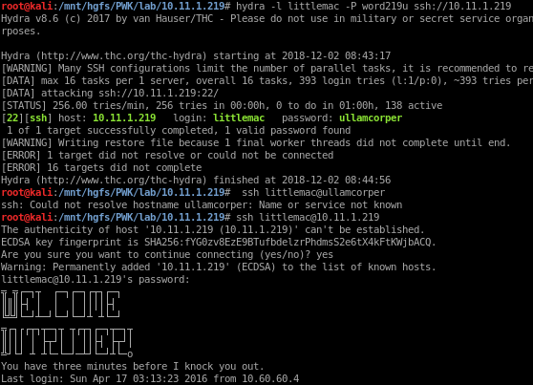
Findings
List all the findings in a single chart with basic details
Vulnerability, hosts, risk
Break down each vulnerability into detailed subsections
Detailed technical description
Include method of discovery and exploitation
Impact to assets
Risk rating and calculations
Remediation recommendations
Include screenshots!
These illustrate our findings and may help show off impact
Use arrows to guide viewer
Make sure they are necessary
Don't overdo it or use as a filler

Slide 28
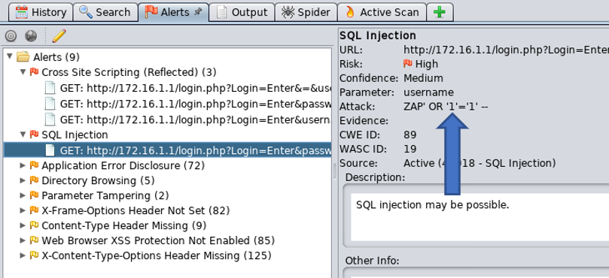
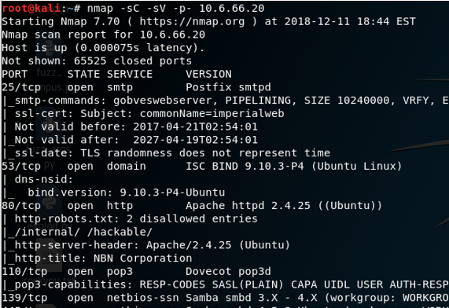
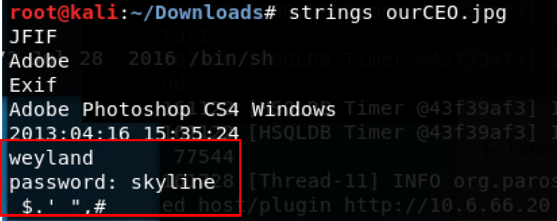
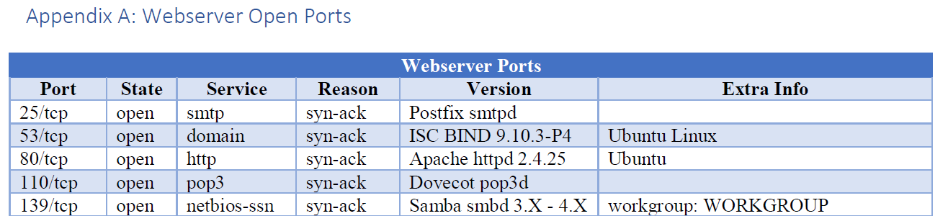
Screenshots - Do's and Don't's
Don't: Raw output from common tools
Do: Edit, Highlight, or Convert to a more appealing format

Slide 29
The Recommendation
For all findings, do provide at least one recommendation to mitigate the risk, more are better
Recommendation types:
Patching
Changing configuration
Fixing software error
Including a security control: Anti-virus, firewall, IDS, or other network filter
Change policy, procedure, or process
Technical issues can be corrected by non-technical means
Include how to test that their fix is successful

Slide 30
Conclusion
There should be no new information provided in the conclusion
Summarize the project and test
Summarize the scope and the targets
Reiterate the overall risk rating
List the significant findings and their business impact
Explain any immediate required actions
Very similar to the executive summary – redundancy is good

Slide 31
Appendixes
This is the best place for long lists, cumbersome results, or raw tool output
Include target list here if its exhaustive
Vulnerability scanner output
Copies of memos, waivers, rules of engagement, other pre-test documents
References, diagrams, other useful documents

Slide 32
Redundancy
Executive Summary? Intro? Conclusion?
Why are they repeating themselves??
The report COULD be read as one document but it rarely is
Think of your report as several reports containing similar information, just oriented different
Each section of your report will be read by different people
Executive Summary - Executives, Managers
Intro, Findings - Project leads, team leads, system owners
Methodology, Recommendations - Engineers and Administrators
Conclusion - Everyone

Slide 33
Module Review

Slide 34
Lesson Wrap up
Pen Testing Process
Prepare – Test – Report
Focus on figuring out expectations, targets, scope, and purpose!
Know the Law
CFAA & DMCA
Always respect Personal Information
US/Cali or EU residents, and obligations by organizations
Use legal data details to also help assess impact for your findings
Report writing
A good pen tester is only as good as the report they write
Please make sure to use this lesson in your future assignments and the final project!

